Slide 2
WHO IS PART of the TEAM?
Community & Aboriginal Government Reps
Funders
Researchers/Universities
Facilitators or Catalysts
NAME TAG LABELS

Slide 3
Recording
Notes (both recorders and pages to assist you with taking your own notes)
Observers recording general observations
Videographer – asking what are you seeing on the ground at home
Artist Alison McCreesh - to create visual representations of what she is hearing
Map with your notes on what you are seeing

Slide 5
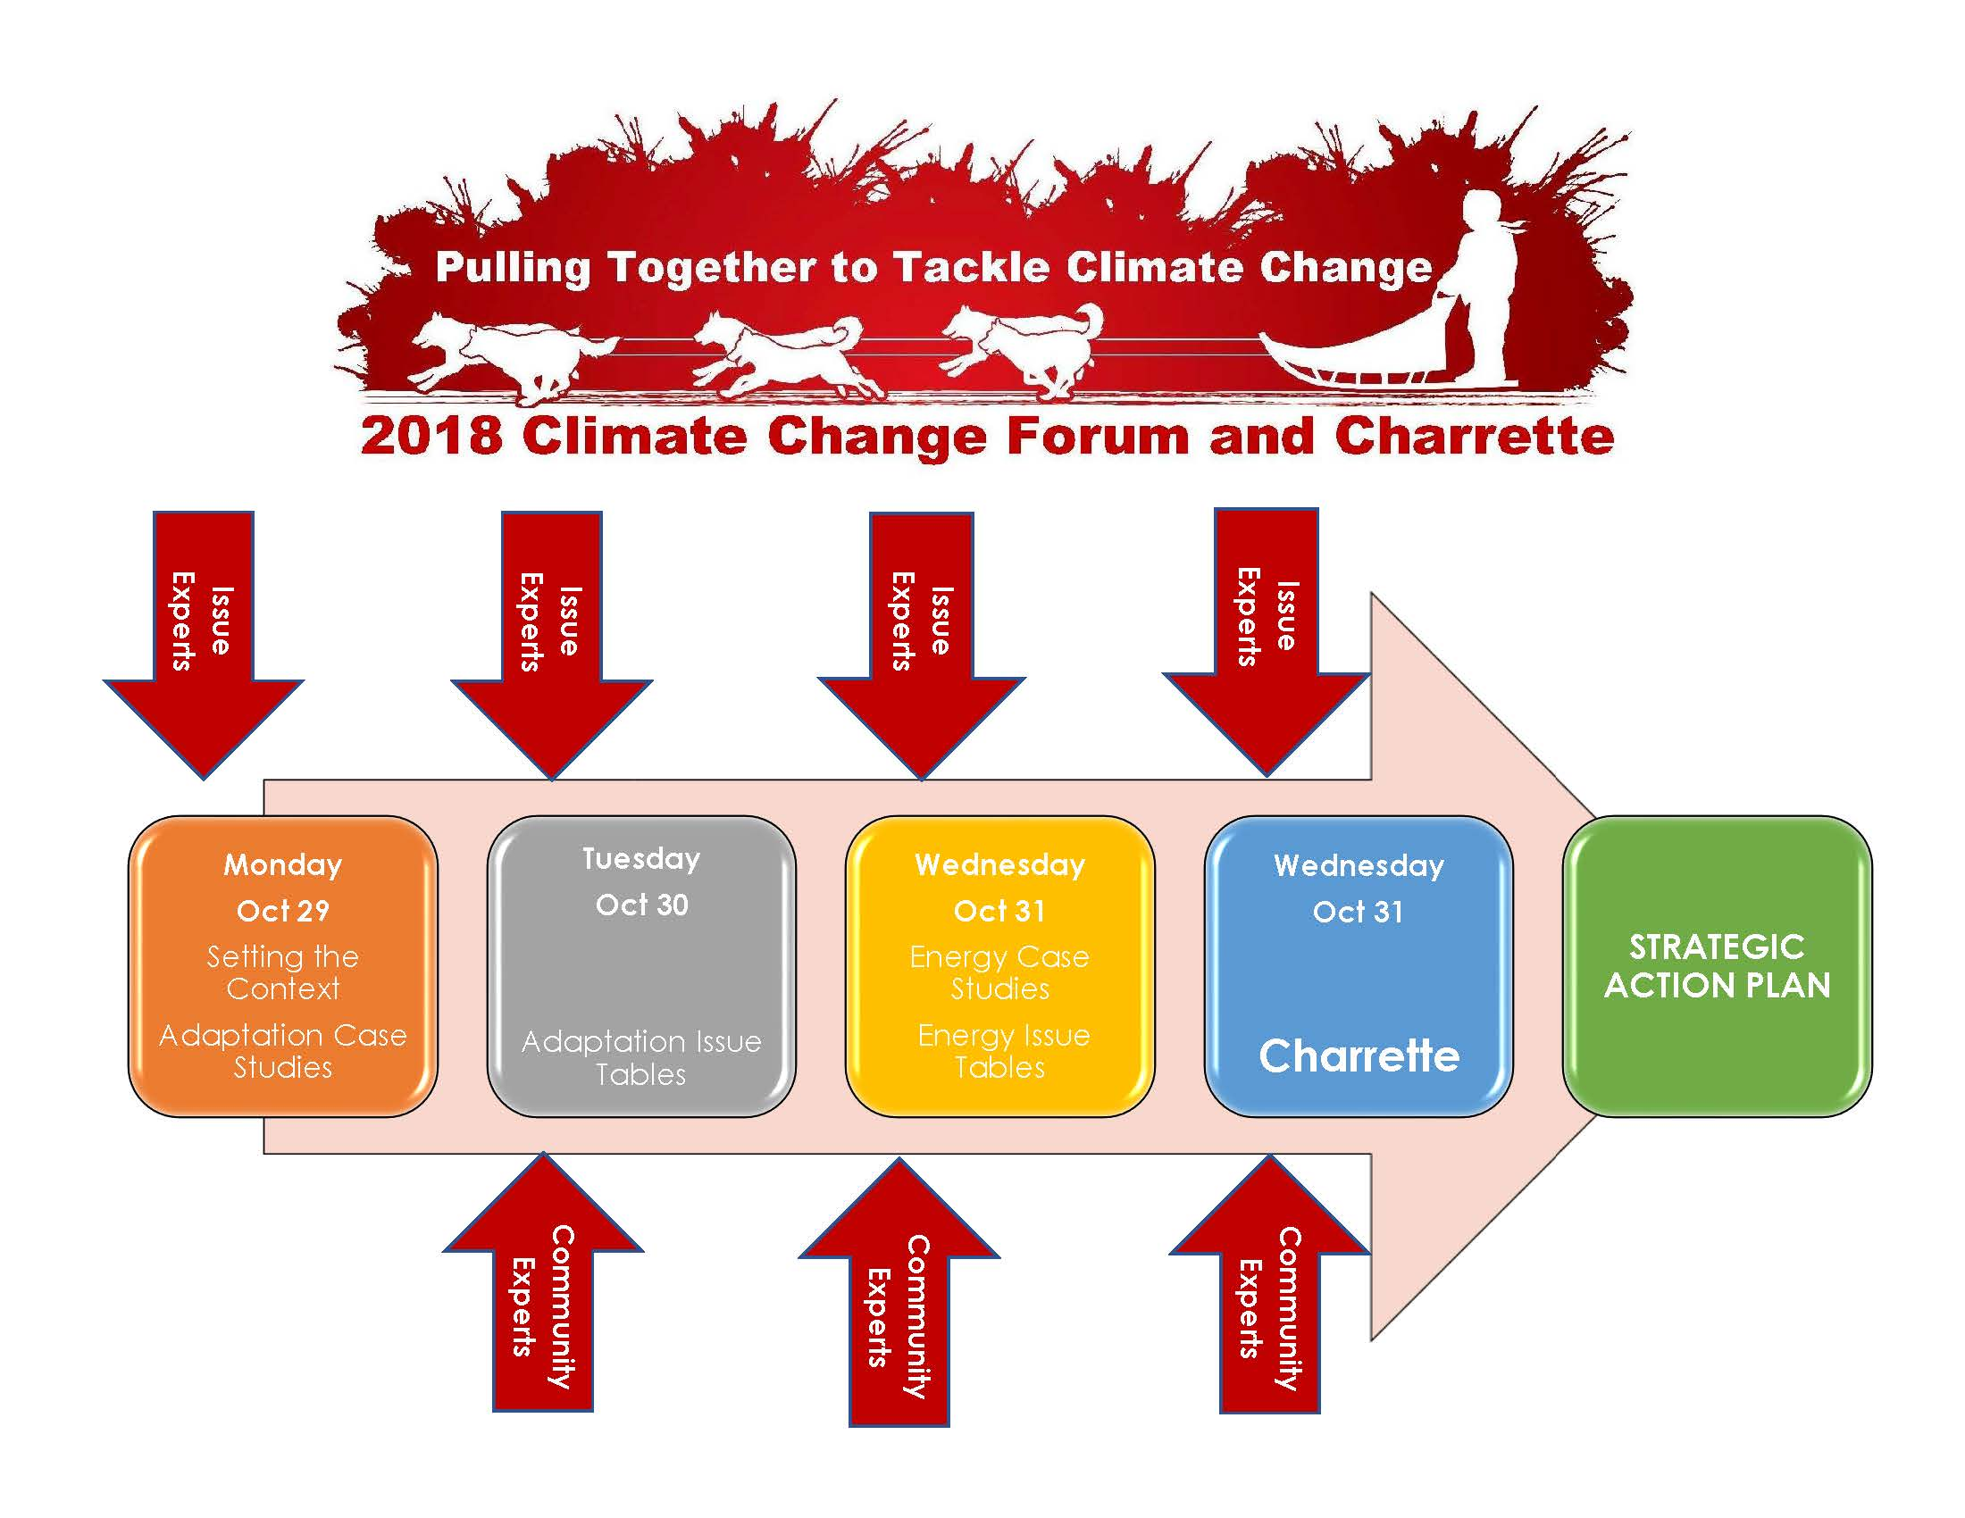

Slide 6
Adaptation Case Studies
Jean Marie River: Margaret Ireland (Jean Marie River First Nation)
Ulukhaktok: Donna Akhiatak (Nunamin Illihakvia project coordinator)
SmartIce: Andrew Arreak (Nunavut Operations Lead for SmartIce, based in Pond Inlet) and Trevor Bell (SmartIce and Memorial University)
Kakisa: Melaine Simba (Ka’a’gee Tu First Nation) and Andrew Spring (Wilfred Laurier University Researcher)
Gameti: David Wedawin (Gameti Chief) and Judal Dominicata (SAO of Gameti)

Slide 7
Tools in your Toolkit
Guide
Standards
Videos

Slide 8
Adaptation Interactive Issue Tables
Permafrost
Coastal/River Erosion
Wildfires
Economic Development
Human Health & Well Being
Transportation
Flooding / Extreme Weather
Water & Waste
Access to Land
Agriculture & Food Security
Attend 9 of 10 sessions to complete your bingo card
Be entered to win a prize!

Slide 10
Energy Case Studies
Hamlet of Aklavik: Fred Berens (SAO of Aklavik)
Arctic Energy Alliance: Mark Heyck (ED of AEA)

Slide 11
Energy Interactive Issue Tables
GNWT Funding Programs
Federal Funding Programs
MACA – School of Community Government
Understanding your power bills
Arctic Energy Alliance Programs
Attend 4 of 5 sessions to complete your game card
Be entered to win a prize!

