Slide 1
Aklavik
Climate Change 2018

Slide 2
Aklavik Breakup 2006

Slide 3
Charles and Anne Lindbergh land in Aklavik, August 5 1931

Slide 4
Rainstorms and highwater levels on Mackenzie and Peel rivers pushed cabin away CBC News · Posted: Jul 18, 2012 4:37 PM CT | Last Updated: July 19, 2012

Slide 5
Aklavik today

Slide 6
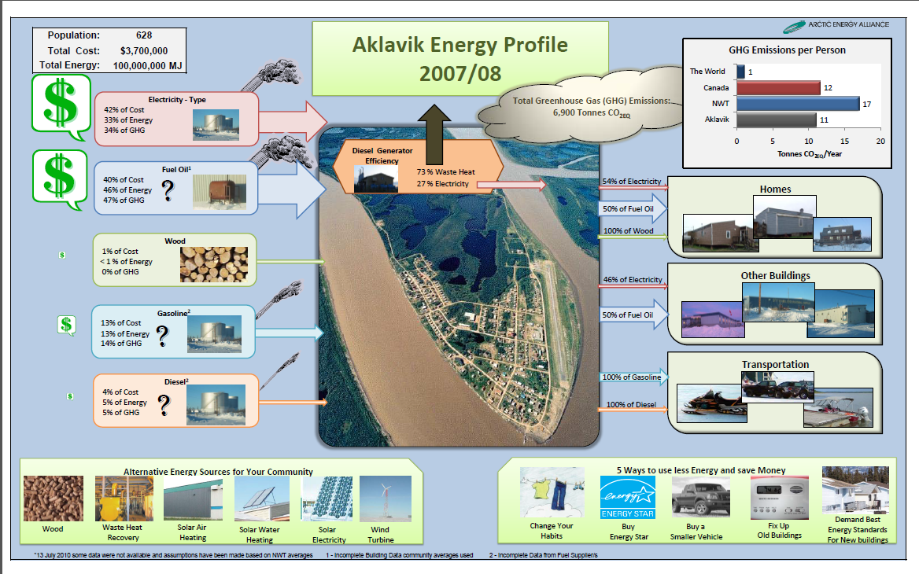

Slide 7
SAO Staff House with 3Kw Solar installed 2015

Slide 8
Solar Panels on Staff House

Slide 9
Converted High Pressure Lights to LED 2015

Slide 10
Aklavik Peel River Garden Society 2016

Slide 11
Recreation Center 15Kw install 2016

Slide 12
Installing Recreation Solar Panels 2016

Slide 13
Solar Panels on Recreation Complex

Slide 14
NTPC’s 55Kw Solar System installed 2016 operational January 2018

Slide 15
Partnership begins AEA, NRCanada and the Hamlet of Aklavik

Slide 16
Introductory Workshop In Yellowknife January 2017

Slide 17
Single Mothers workshop insulating your home and energy saving tips 2017

Slide 18
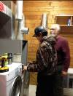
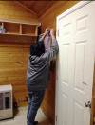
Notes:
Community workshops:
Teach youth to winterize homes

Slide 19
Youth Center/Swimming Pool converted all lighting to LED and upgraded HVAC 2017

Slide 20
Lighting and Censor Upgrades
Building Name | T12, T8 or T5 bulbs → LED (# of fixtures) | Occupancy sensors | Exterior lighting HID → LED | Emergency lighting
Arena Complex | 200 bulbs, (79 fixtures) | 5 | -
Fire Hall | 75 bulbs, (32 fixtures) | 2 | - | 3 remote heads
Youth Center/ Pool | 100 bulbs, (42 fixtures) | - | 5 | 11 remote heads
Curling Rink | 230 bulbs, (102 fixtures) | - | 6 | 2 batteries
Total | 605 bulbs, (255 fixtures) | 7 | 11
Building name | Electricity | Oil | Savings | Cost | Payback | Reduction in GHG emissions
Arena | 16,600 kWh | -1,400 L | $12,600 | $18,100 | 1.4 years | 9.2 tC02e
Fire Hall | 4,700 kWh | -380 L | $3,500 | $9,100 | 2.6 years | 2.6 tC02e
Youth Center/Pool | 2,700 kWh | -130 L | $2,100 | $13,900 | 6.5 years | 1.7 tC02e
Curling Rink | 11,200 kWh | -340 L | $9,200 | $20,800 | 2.3 years | 7.8 tC02e
Water Treatment Plant | 2,500 kWh | -130 L | $2,000 | $4,300 | 2.1 years | 1.6 tC02e
Maintenance Garage | 1,800 kWh | -140 L | $1,500 | $6,000 | 4.0 years | 1.0 tC02e
Total | 40,000 kWh | -2,500 L | $31,000 | $72,000 | 2.3 years | 23.9 tC02e

Slide 21
Sittichinli Recreational Complex converted all lighting to LED and upgraded HVAC 2017

Slide 22
Sittichinli Community Hall Side with LED upgrade 2017

Slide 23
New Fitness Center Built 2017 attached to Complex

Slide 24
Firehall HVAC upgrade and light conversion 2017

Slide 25
Work Identified during HVAC scoping visit and approved by Council
Building Name | Work list
Arena Complex | Service & clean the HRVs Service the oil fired water heater Install programmable thermostats Install log book in mechanical room and HRV room
Fire Hall | Boiler oil burner service Install a Tekmar boiler controller Install a section of larger diameter fuel pipe inside building to allow oil to warm up before combustion. Install a side-stream filter to help keep glycol clean. Replace existing large electric water heater with small space saver model Extend return air duct down to low level to pull cool air from floor Replace existing large unit heater with two smaller unit heaters Replace force flow heater with a section of 1 1/4 baseboard radiation Install programmable thermostats Install log book in mechanical room
Youth center/ pool | Install a backdraft damper on pool exhaust air Revise heating piping over the door in the hall to reduce chance of trapped air Install programmable thermostats Boiler oil burner service Install a sidestream filter to help keep glycol clean Insulate bare copper heating piping in crawlspace Approximately 100Ft Install log book in mechanical room and crawlspace
Curling Rink | Install a sidestream filter to help keep glycol clean Boiler oil burner service Install programmable thermostats Install log book in mechanical room

Slide 26
Expected savings from heating project
Building name | Electricity | Oil | Savings | Cost | Payback | Reduction in GHG emissions
Arena |  | 8,900 L | $14,800 | $6,500 | 0.4 years | 23.9 tC02e
Fire Hall | 2,200 kWh | 3,400 L | $7,500 | $37,000 | 5.0 years | 10.7 tC02e
Youth Center/Pool |  | 4,000 L | $6,600 | $18,000 | 2.7 years | 10.8 tC02e
Curling Rink |  | 4,400 L | $7,300 | $20,000 | 2.7 years | 11.8 tC02e
Total | 2,200 kWh | 20,700 L | $36,000 | $81,500 | 2.3 years | 57.2 tC02e

Slide 27
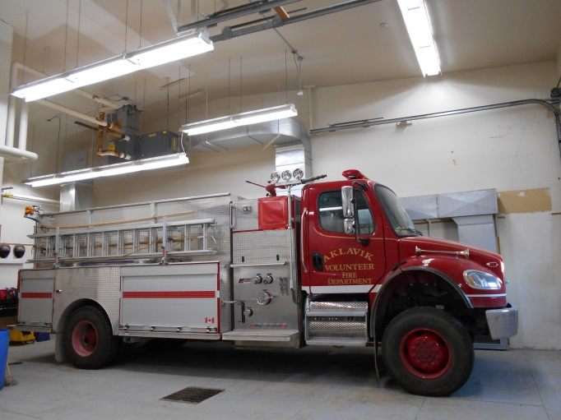
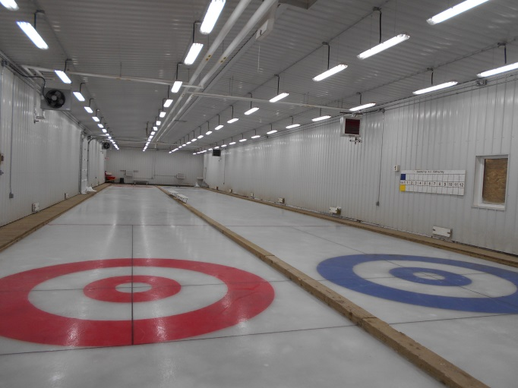
Notes:
LED lighting upgrade

Slide 28
Aklavik Curling Rink converted all lights to LED inside and outside upgraded HVAC 2017

Slide 29
Water Plant Light conversion 2017

Slide 30
Public Works Garage Light Conversion 2017

Slide 31
Updated and Council Approved Strategies of Community Energy Plan 2017

Slide 32
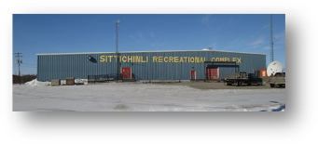
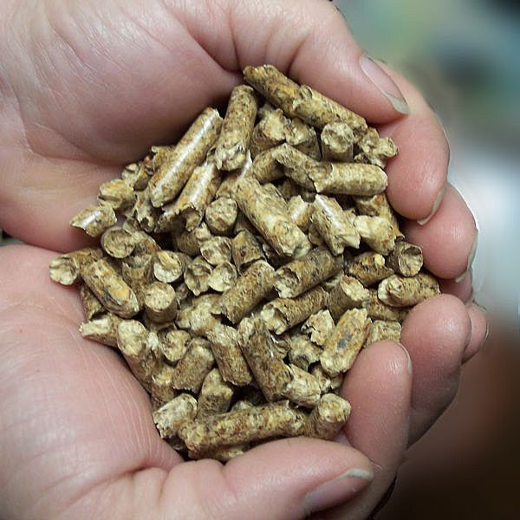
Notes:
Biomass study

Slide 33
Bio-Mass Heating system applied for funding under the NR Canada Clean Energy for Rural and Remote Communities May 2018

Slide 34
Currently in the Second Phase of the Process October, 2018
Clean energy for rural and remote communities (CERRC)
BIOHEAT program stream
RISK ASSESSMENT QUESTIONNAIRE
To Be Completed by applicant

Slide 35
Reusing Tires for Erosion Control used 22 commercial tires bolted together in 3 rows

Slide 36
Aklavik’s own Olympians, Kevin Koe, Sharon and Shirley Firth

Slide 37
Thank you
INUVIK, N.W.T. (Dec 27, 2007)
Charlie Furlong knows the lands and waters of the Mackenzie Delta like a childhood chum, but now his old friend is acting strange.
"The Gwich'in, you know, we're used to adapting, so that's what it is now," says Furlong, chief of the Aklavik Gwich'in First Nation, tucked high up in the top left shelf of the continent.
Viewed from the south, Arctic climate change can seem a confusing ecological and geopolitical tangle, accompanied by a media montage of stranded polar bears and melting sea ice, along with political debate that gives a whole new meaning to the phrase "gas-emitting."
But from the stance of one man on the land he loves, it's not so complex.
"It's a lot warmer," Furlong says. "Winters are not as long as they used to be.
"(The river's) high in the spring and the cycle of animals is not the way it used to be. They're seeing strange birds that never used to come this far. A couple years ago, they saw a blue heron.
"In Aklavik, where I come from, they've seen seals in the area. They had a whale this summer, and in fall they had polar bear come up into the area. Animals are migrating further than they normally should in search of food."
Furlong shrugs. "Elders always say that's God's way of testing us."
If so, Furlong's people are being tested harder than almost anyone on earth. His corner of the world is a global hot spot for climate change, where consequences are expected to hit first and hardest.

